Slide 1
Artificial Intelligence Assisted Galactic Archaeology
Mullard Space Science Laboratory
Student: Tom Crossland
Supervisor Team:
Daisuke Kawata (Primary), Tom Kitching, Jason McEwen (MSSL, UCL)
Pontus Stenetorp, Sebastian Riedel (Machine Reading group, Computer Science, UCL)
Notes:
My name is Daisuke Kawata from Mullard Space Science Laboratory, UCL. Today I’ll talk about Impacts of a flaring disk and radial mixing on Galactic Disc. These are my collaborators. Chris Brook and Brad Gibson is my long time collaborators in this topic.

Slide 2
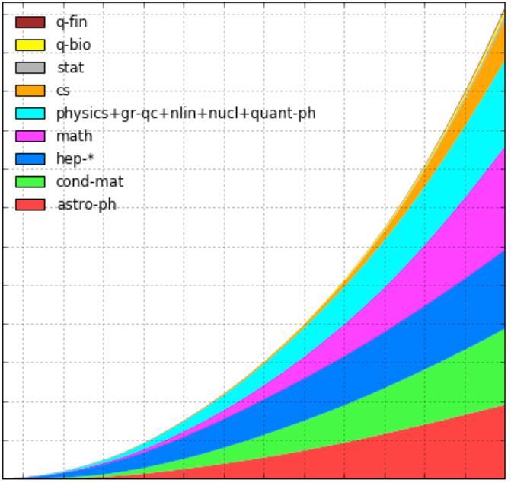
How can we reveal a global picture of the Milky Way from increasing number publications?
1,200,000
1,000,000
800,000
Cumulative arXiv submissions
600,000
400,000
200,000
astro-ph
1992
1996
2000
2004
2008
2012
2016

Slide 3
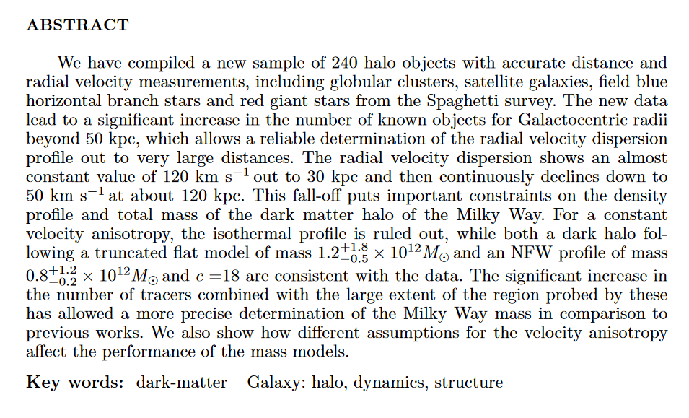
Measurement Extraction
https://arxiv.org/abs/astro-ph/0506102

Slide 4
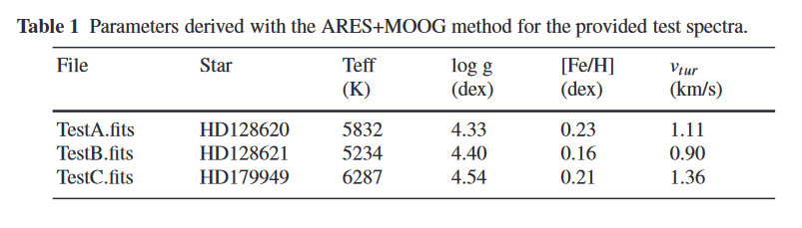
Tabulated Data
https://arxiv.org/abs/1711.01839

Slide 5
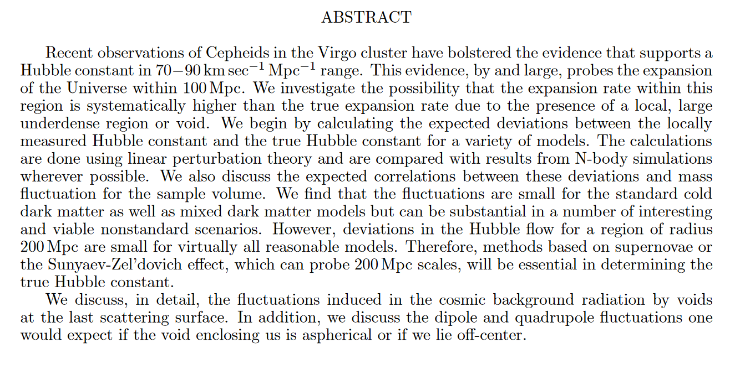
Range Data, Units, etc.
https://arxiv.org/pdf/astro-ph/9506120

Slide 6
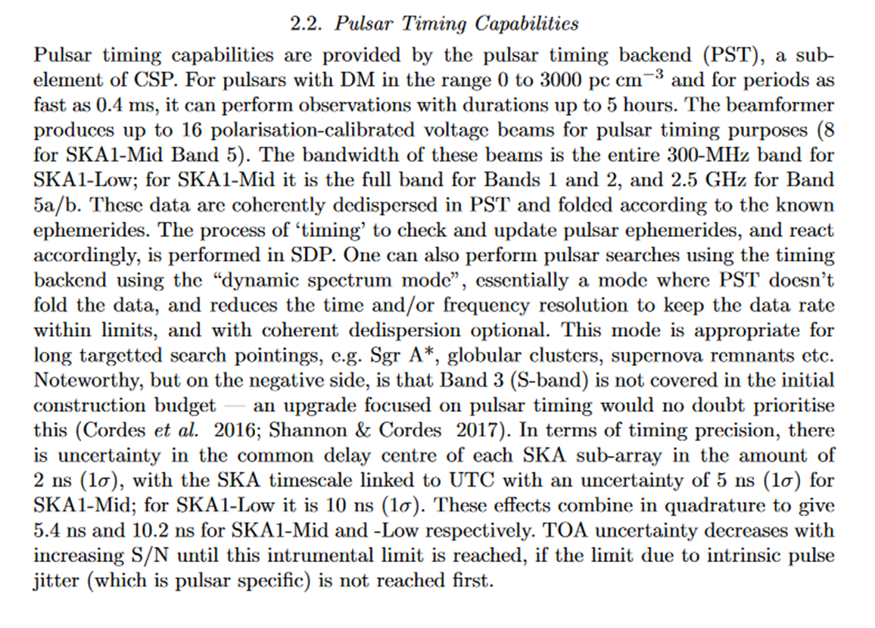
Multi-Sentence Data
https://arxiv.org/abs/1711.01910

Slide 7
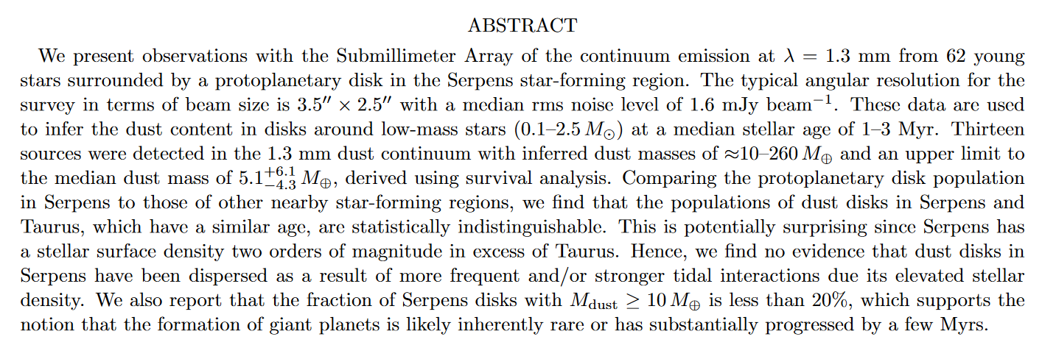
Conditional Data
https://arxiv.org/abs/1711.01266

Slide 8
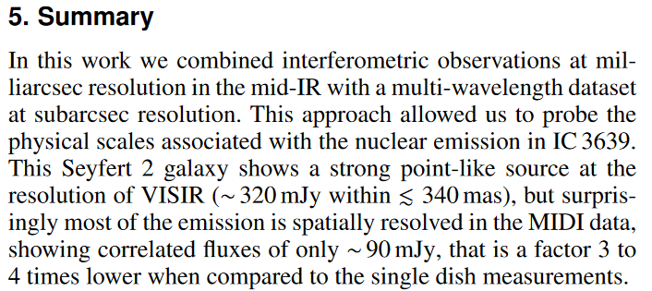

Units
$$1 Jy={10}^{−16} W m^{−2} {Hz}^{−1}= {10}^{−23} erg s^{−1} {cm}^{−2} {Hz}^{−1}$$
https://arxiv.org/abs/1711.01268

Slide 9
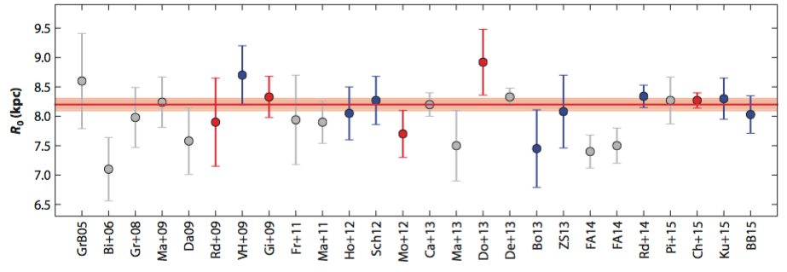
New consensus starts emerging?
2005
2015
Last 10 years of published distance to the Galactic centre, R0. Bland-Hawthorn & Gerhard (2016)

Slide 10
Data Pre-Processing
Extract .tex (and .tab, .cls, etc.)
Convert .tex to .txt
→ delatex
Sentence split and tokenize

Slide 11
Next Steps
Begin with rule-based system
Identify closest numeric token to keyword
Progress to grammar parsing (hopefully)
Find “parameter” tokens and associated numeric token

Slide 12
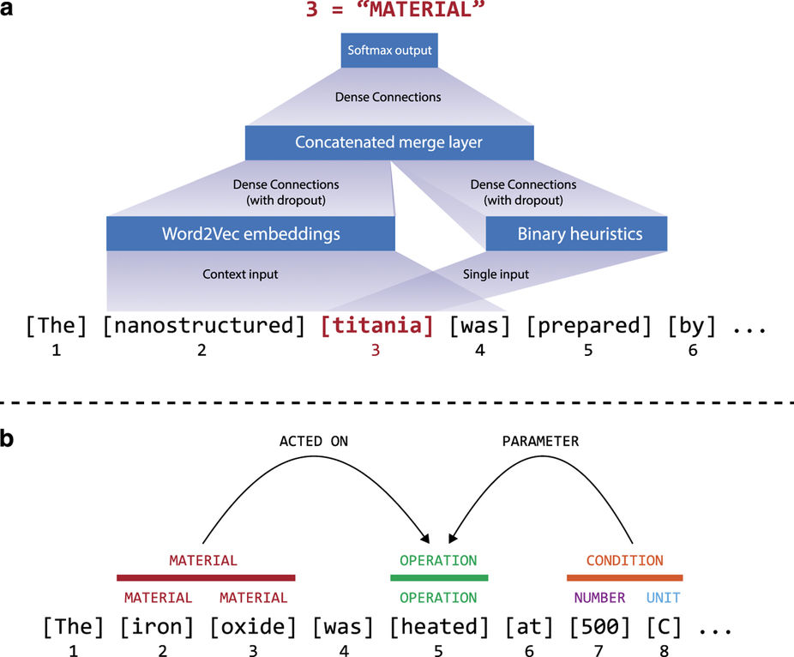
Kim, et al. (2017) Machine-learned and codified synthesis parameters of oxide materials, Scientific Data, 4

Slide 13
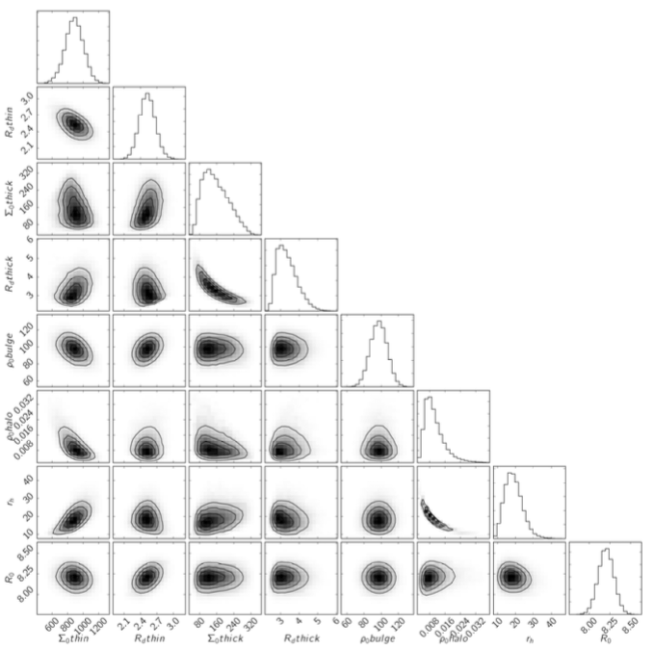
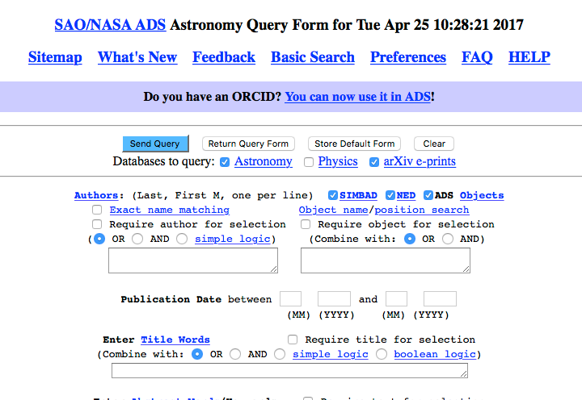

Fully-automated self-updating Galaxy model!
Bayesian Hierachical model:
statistically combine the information with outlier modelling ⇒ a consensus Milky Way model
Machine Reading:
extracting measured values
by different methods and/or data
from all the published papers
McMillan (2017)
w/ UCL Machine Reading Group!

Slide 14
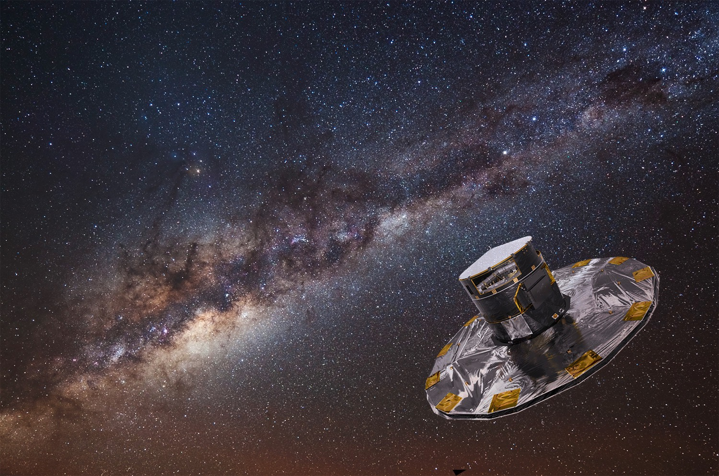
ESA’s Gaia satellite: Launched 19th Dec. 2013 mapping the positions and velocities of over 1 billion stars!
MSSL: CCD and electronics RVS (Radial Velocity Spectrograph) Spectroscopic data processing
Notes:
European Space Agency launched the Gaia satellite on 19th Dec. 2013. Gaia is mapping the position and velocity of over 1 billion stars! My institute MSSL is heavily involved in this mission, and we worked for CCD calibration, electronics, and development of one of the instrument, Radial velocity spectrograph and its data processing unit.

Slide 15
1st Data Release: 14 September 2016
~1/1000 of stars with 20 times lower accuracy,
still produced about 200 related papers in 8 months!
Credit: ESA/Gaia/DPAC
Notes:
Gaia’s official science goal is quantifying the origin, structure and the evolution history of the Milky Way. However, the observational data are huge and complex. For example, this is the Gaia’s first sky map on the projection. There are these dark area, we call dust lane, where we do not see many stars, because high dense gas is blocking the stars behind. So, different area has very different selection biases.

Slide 16
Comparing the Galaxy model with or without Gaia publications. ⇒ impact of the Gaia mission.
Identifying what kind of data and/or analysis made stronger impact on the model? or new consensus? ⇒ what kind of the data are still missing after Gaia?
New consensus starts emerging?
2005
2015
Last 10 years of published distance to the Galactic centre, R0. Bland-Hawthorn & Gerhard (2016)
Applicable to any research topic to capture trends and holistic view of the research area!

